Slide 1


Course: Object Oriented Programming
Software that Fits the World
An Introduction to Object Oriented Programming
Evis Plaku

Slide 2
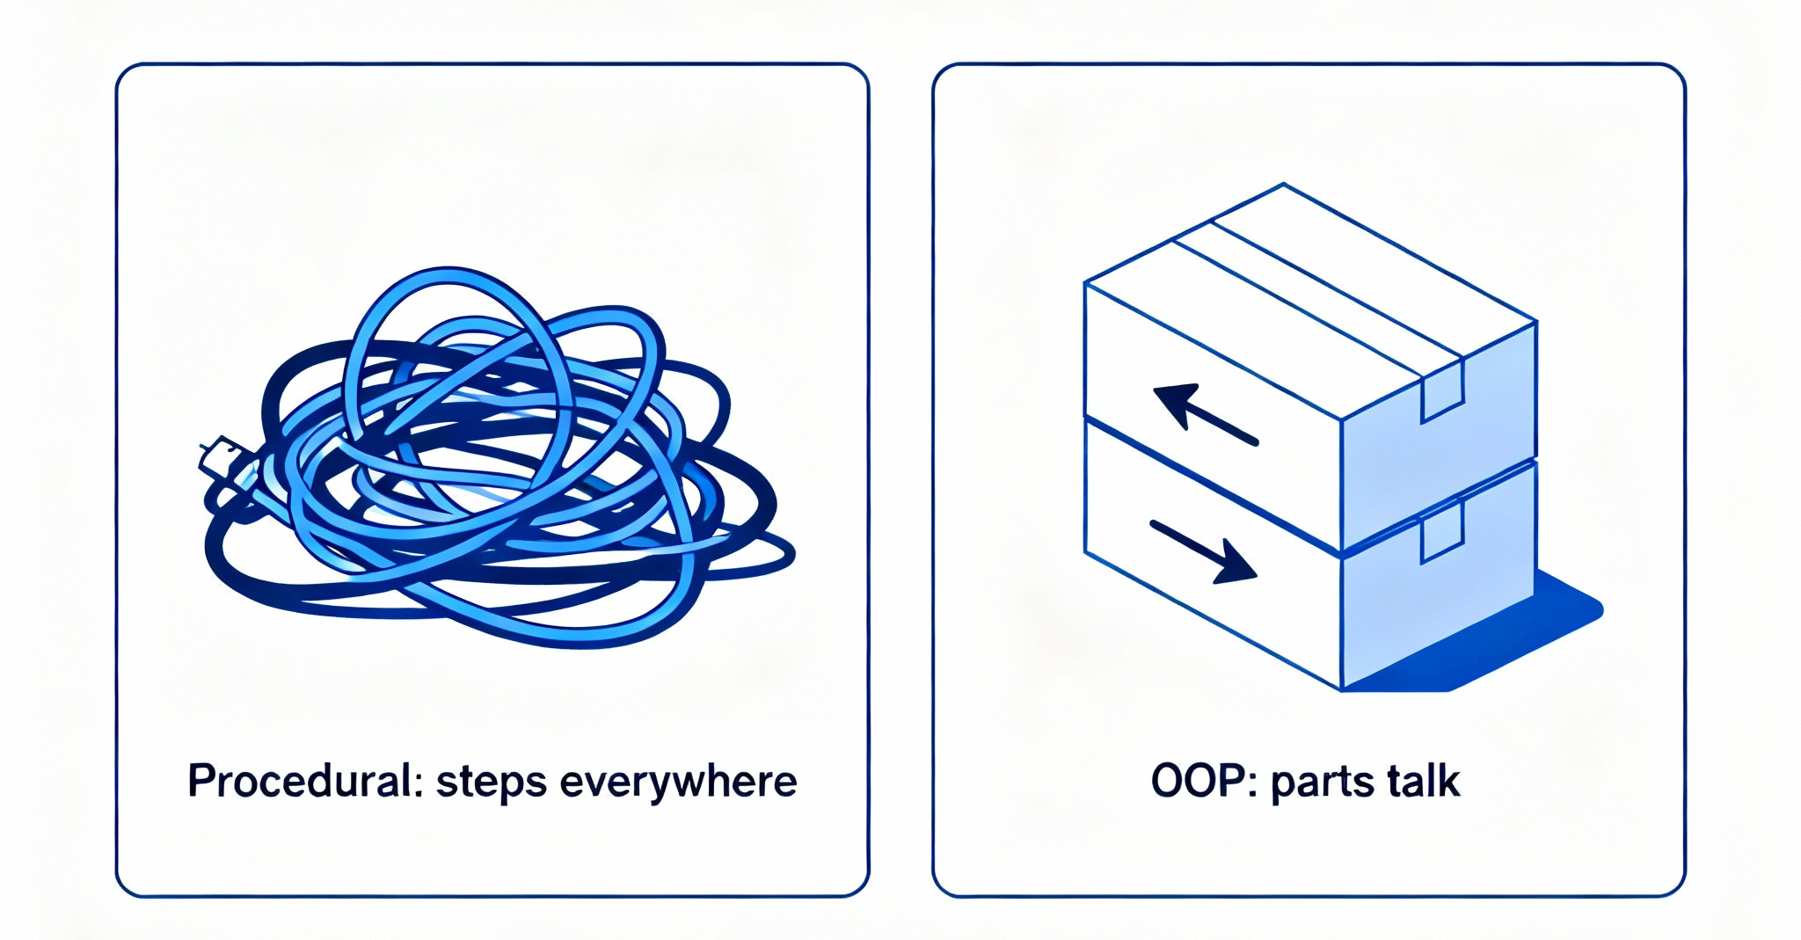
Oop as a paradigm shift
Same problem: a new paradigm

Slide 3

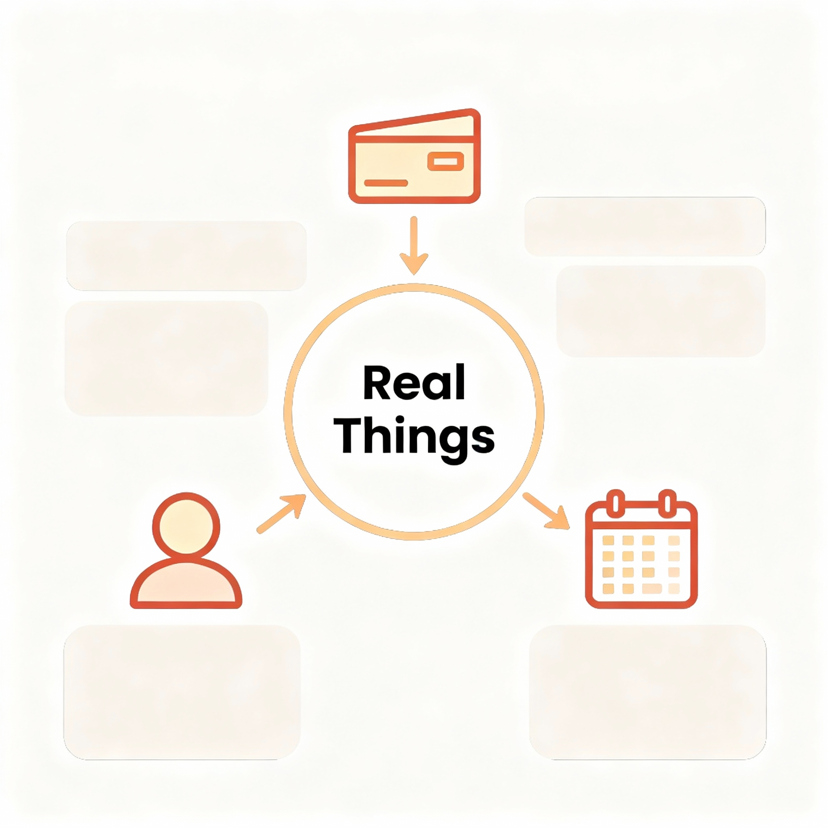
What is this course about
Learn to model real problems with objects for clear, change‑ready code
We organize code around real things and their simple actions
This helps manage complexity as features grow over the semester
Expect practical ideas, plain language, and steady, hands‑on progress

Slide 4

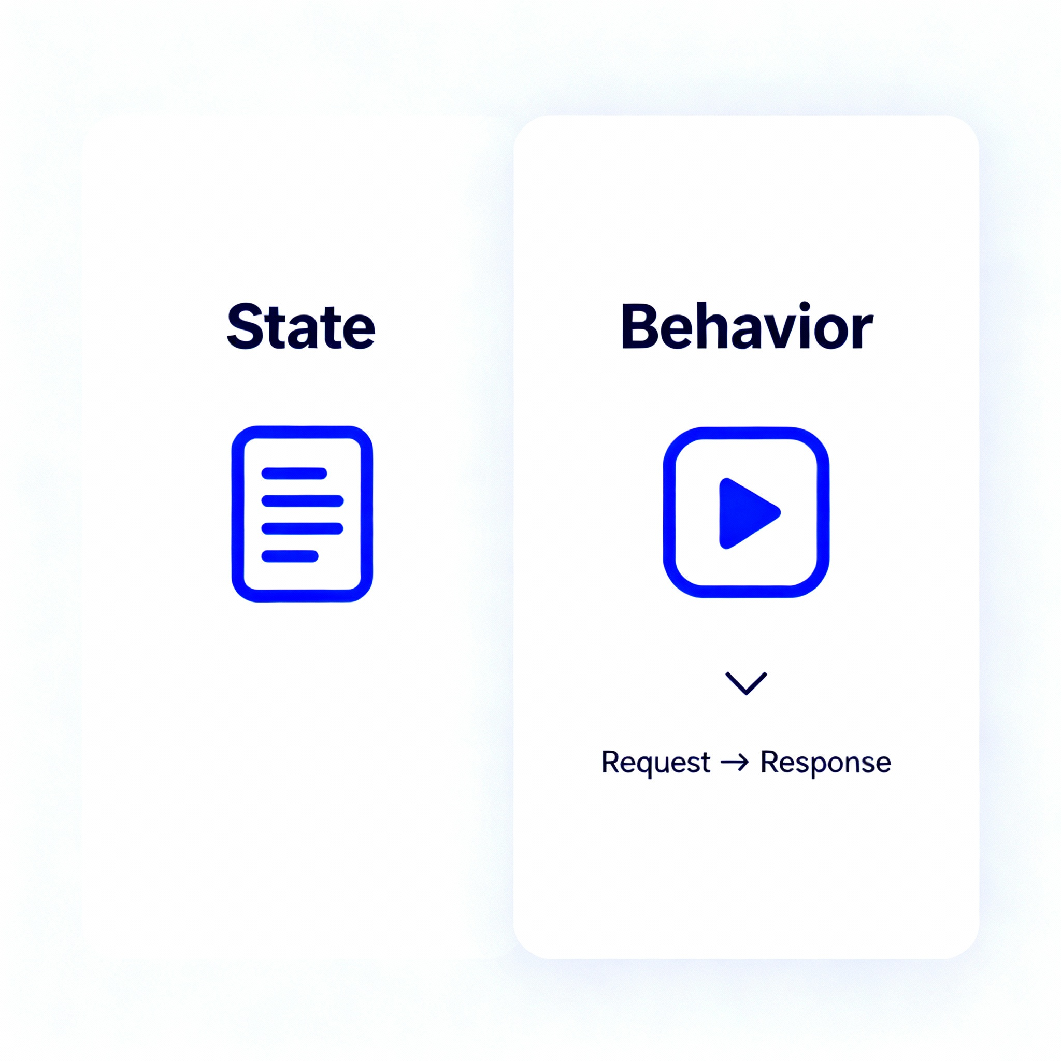
WHY oop exists
It reduces complexity by grouping related data and actions together
Objects reflect how people think: things with state and behavior
Clear boundaries mean changes spread less and break fewer parts
Shared patterns let teams reuse parts instead of rewriting code

Slide 5

Modeling the real world
Turn everyday nouns and verbs into simple software building blocks
Identify key things, their facts, and the actions they perform
Keep each part focused on one role for clarity and change
Let parts interact through small requests, like people cooperating
Entities
Characteristics
Functionalities

Slide 6

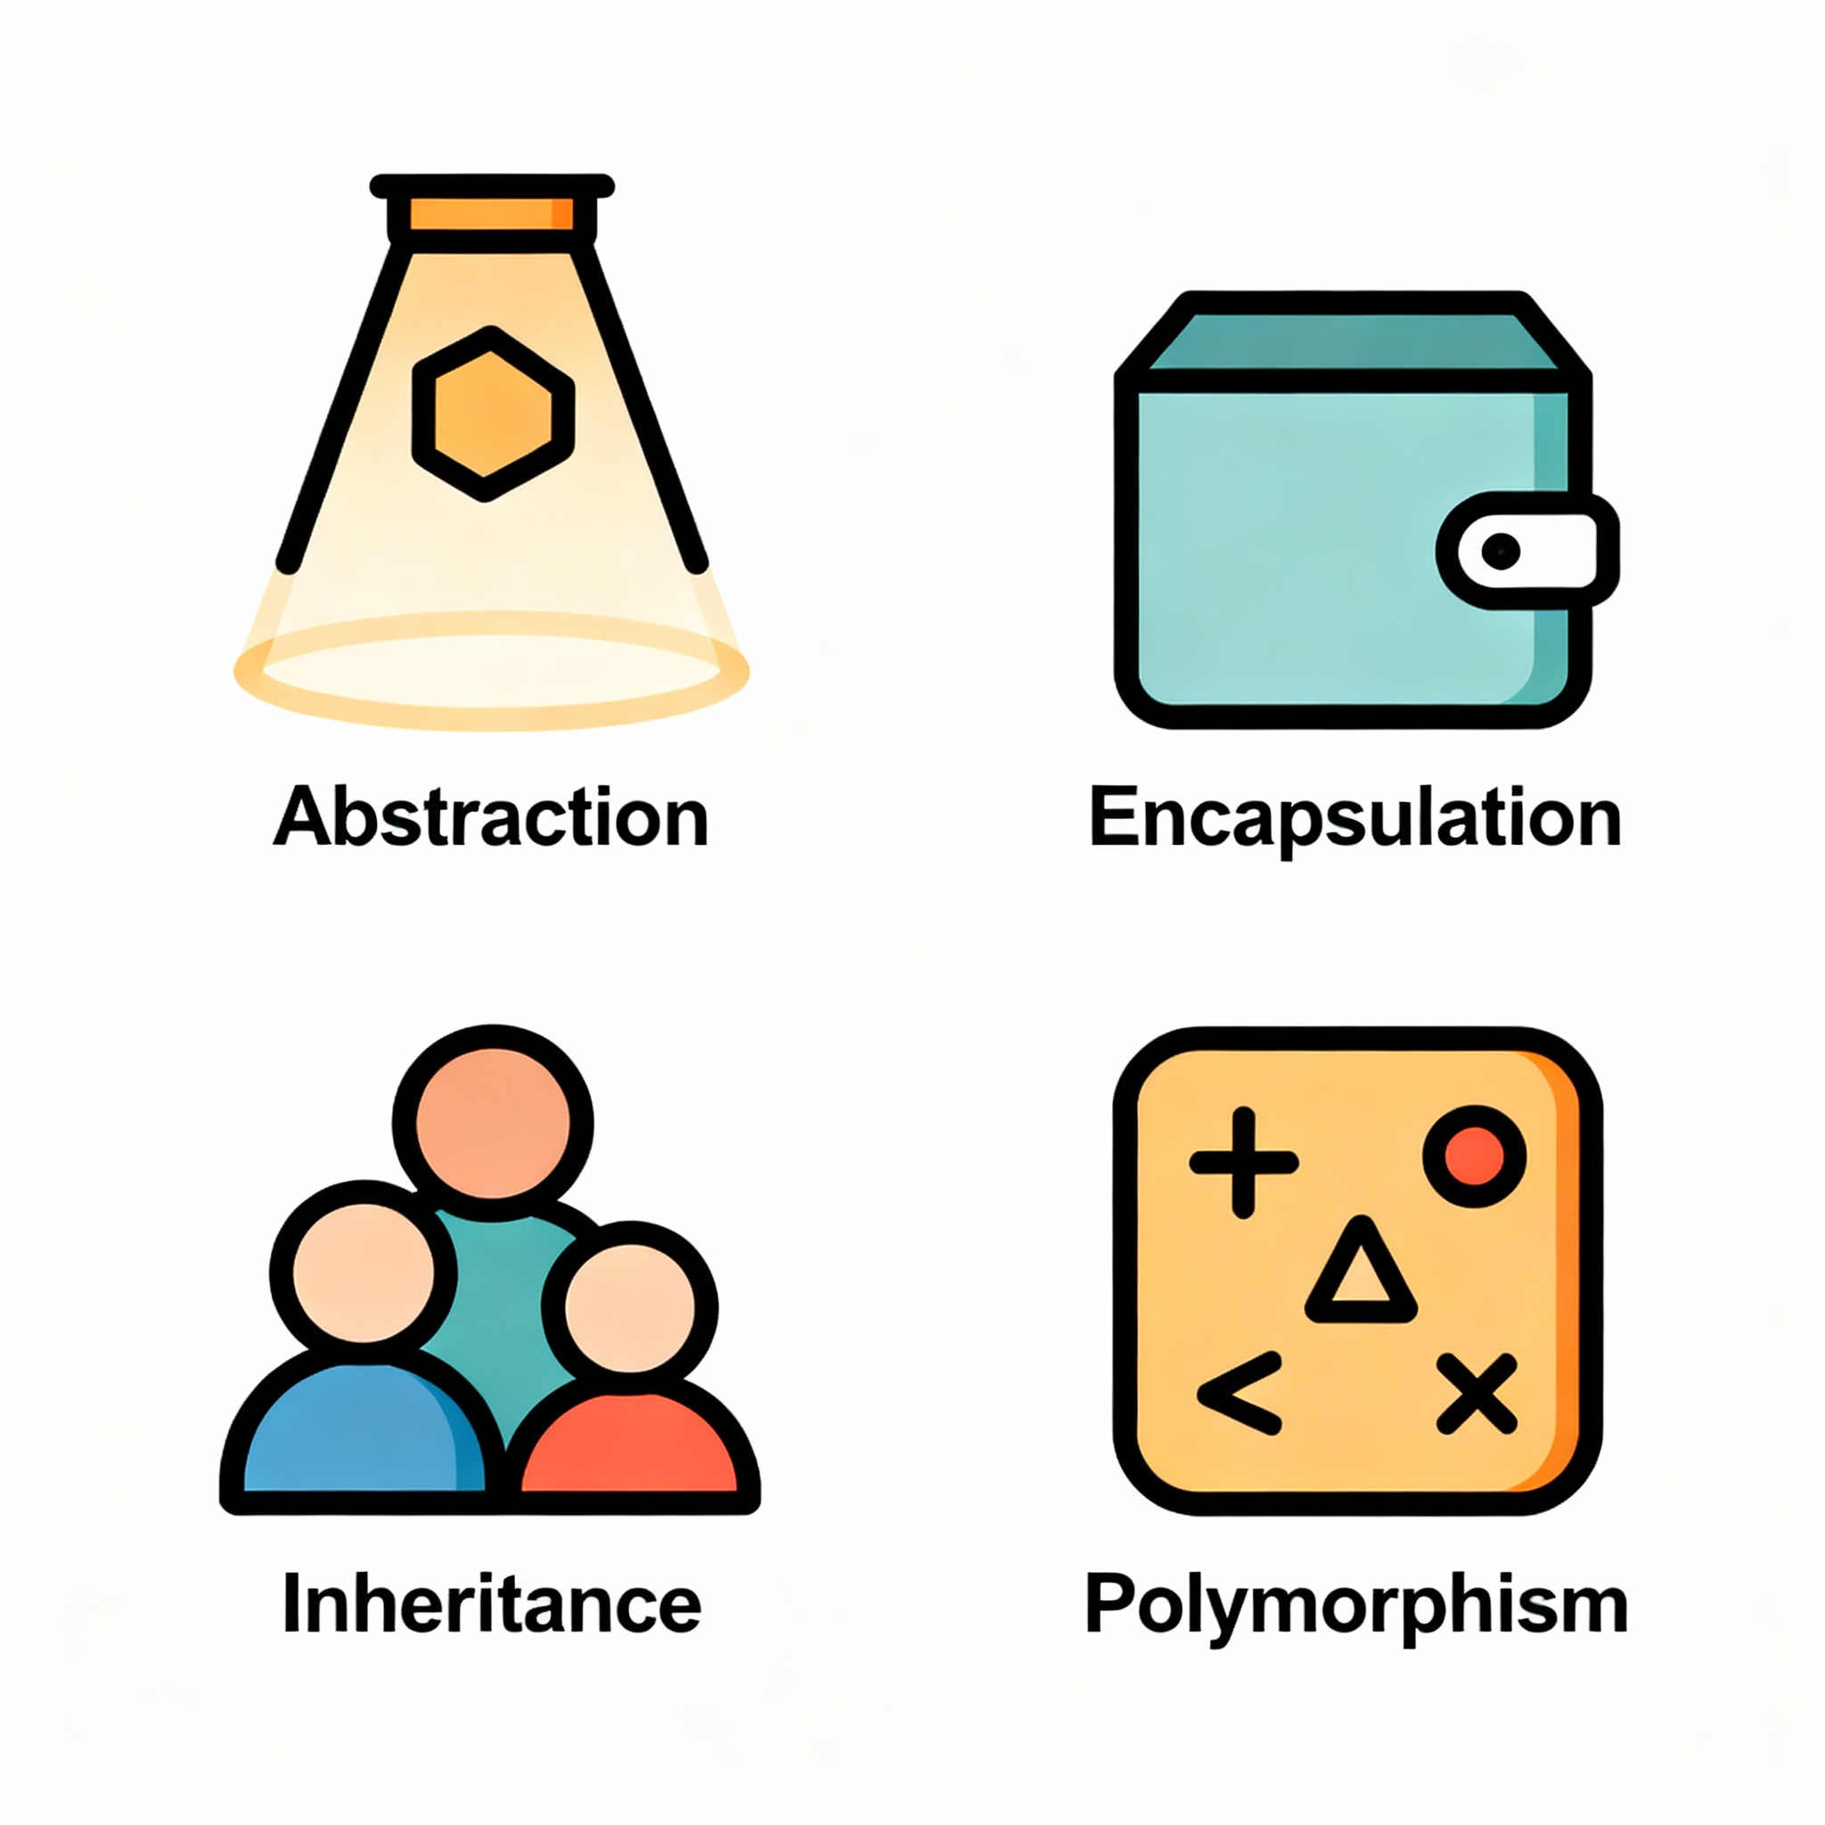
Four key pillars (at a glance)
Principles help with clear design
Encapsulation hides internals, exposing safe, simple ways to interact
Abstraction shows what matters, skipping distracting, low‑level details
Inheritance and polymorphism reduce duplication and simplify extensions

Slide 7

How to think in OOP

Slide 8

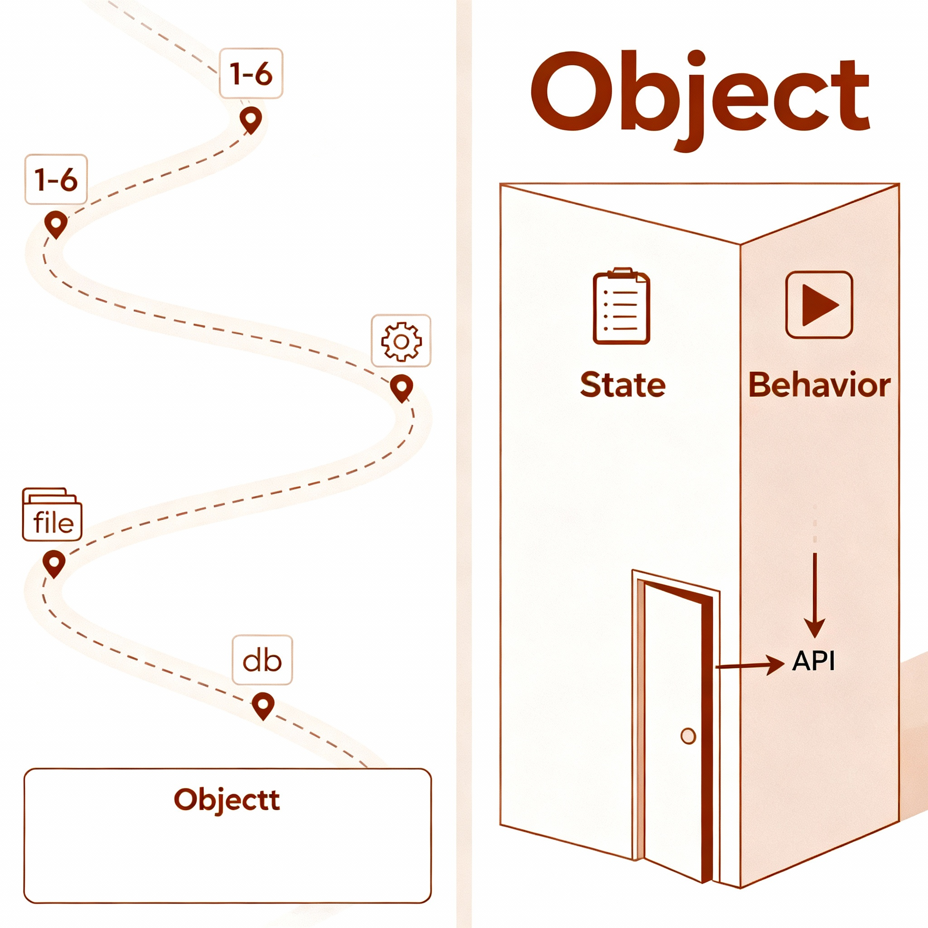
Oop versus procedural thinking
Procedural suits small scripts; OOP scales better for complex systems
Procedural code scatters data and logic across many separate steps
OOP keeps related data and behavior in one clear place
This reduces surprises when systems grow and requirements change
Object

Slide 9

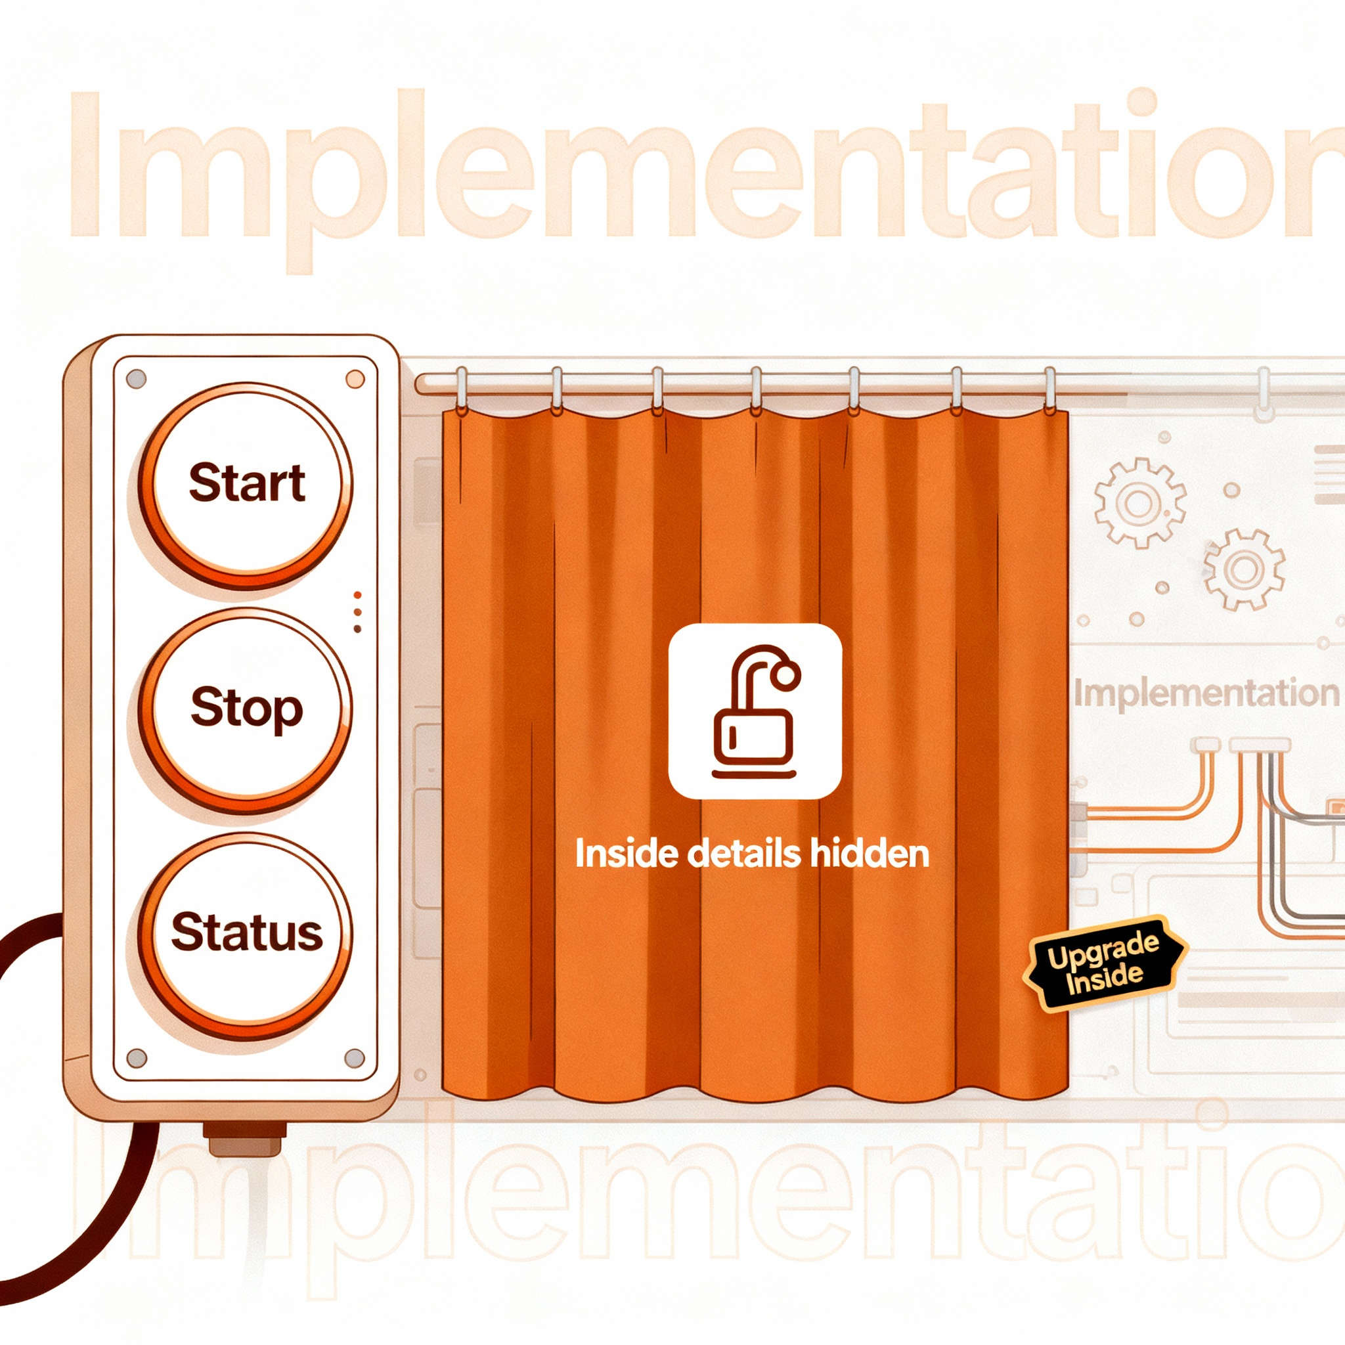
Encapsulation as safety net
Protect state by controlling how other parts can change it
Hide details; present a small surface for safe interactions
Validate inputs at the boundary to keep rules always true
When internals change, outside code stays calm and stable

Slide 10

Abstraction for clarity
Show the essence; avoid exposing unnecessary implementation details
Name capabilities in plain terms users and developers both understand
Keep interfaces simple; move complexity behind the curtain
Stable abstractions make change cheaper and conversations easier

Slide 11

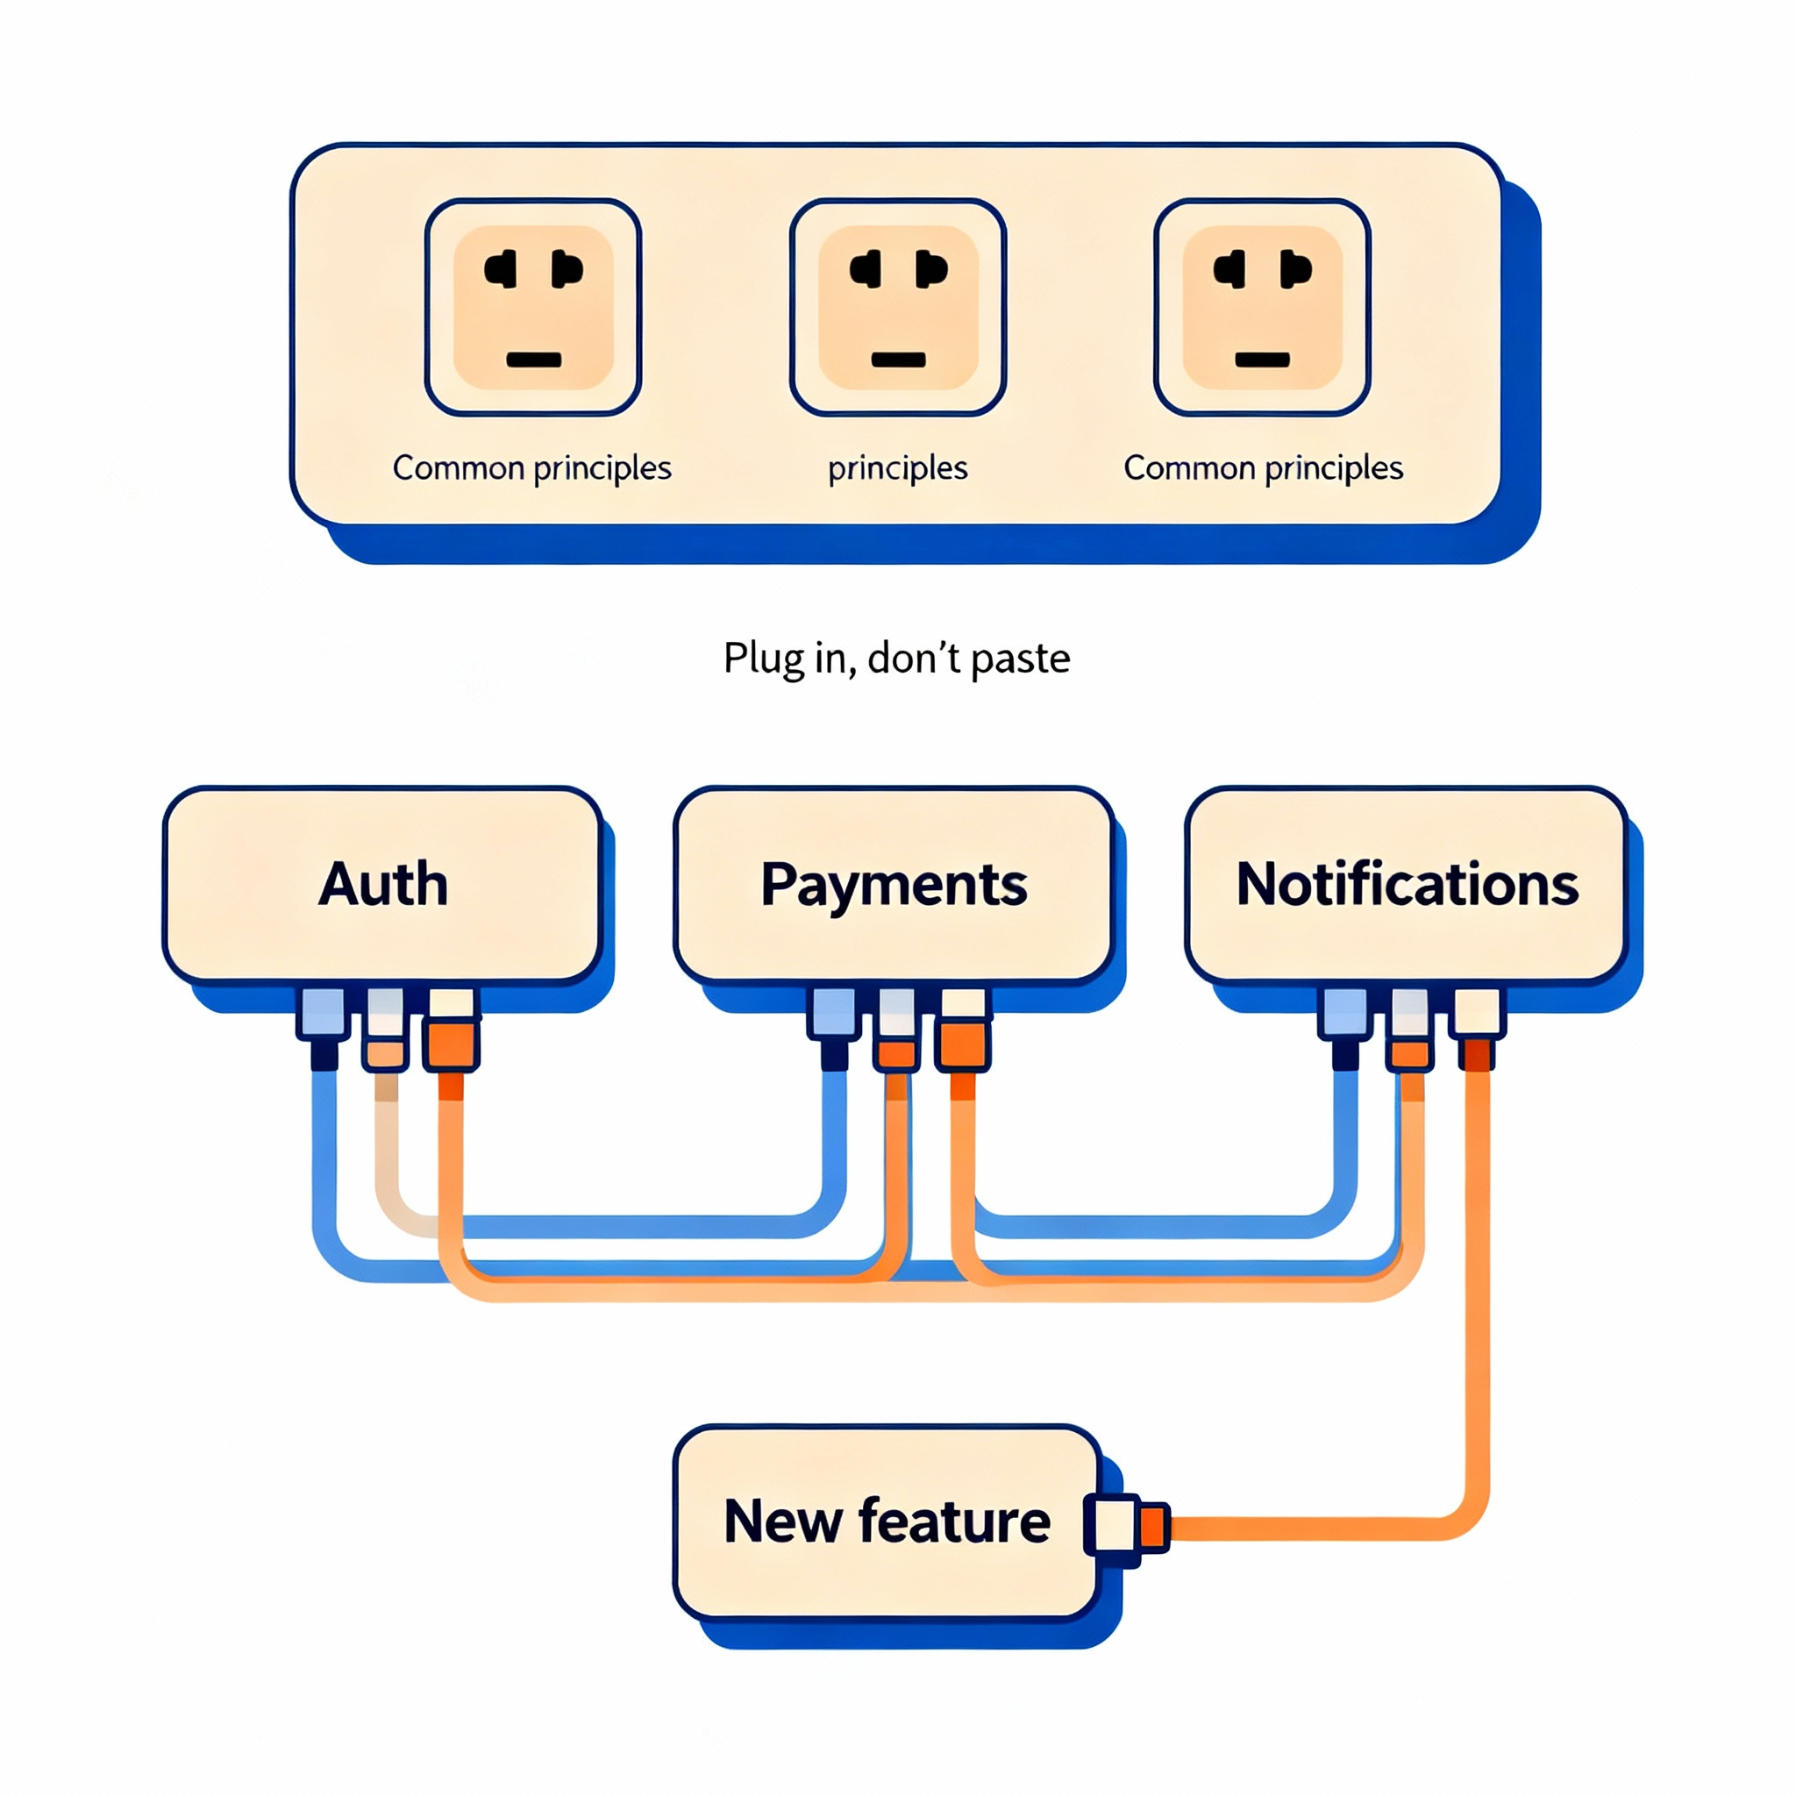
Reuse and extension
Build once, reuse widely; extend behavior without breaking existing parts
Design around common principles so new features fit well with existing ones
Favor plug‑in points over copy‑paste code duplication
Reuse speeds delivery and reduces bugs across teams

Slide 12
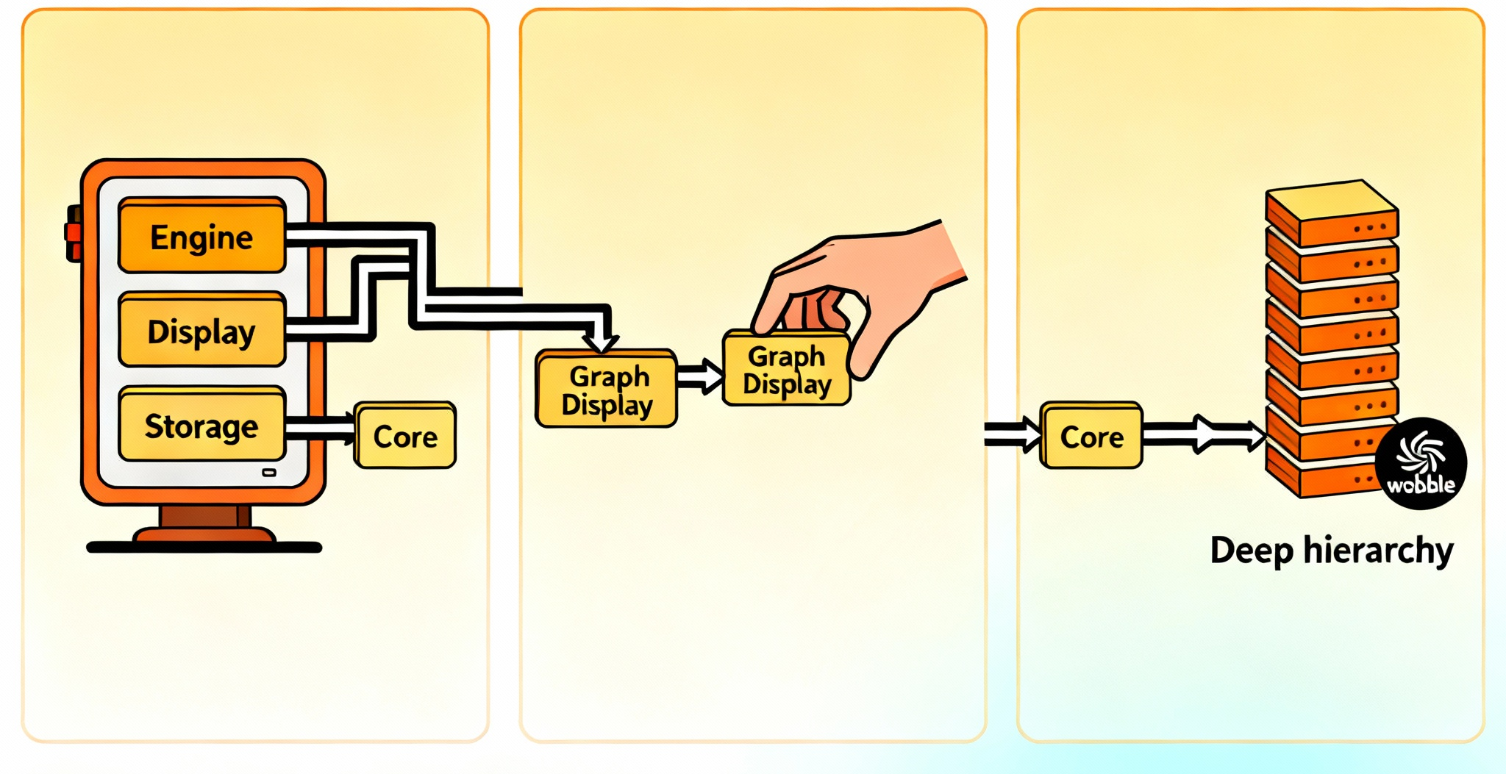
Composition over hierarchy (a preview)
Prefer small parts working together over deep, rigid class trees
“Has‑a” relationships compose features without tight coupling
Swapping parts stays easy when behavior lives in collaborators
Shallow structures adapt better than tall hierarchies

Slide 13

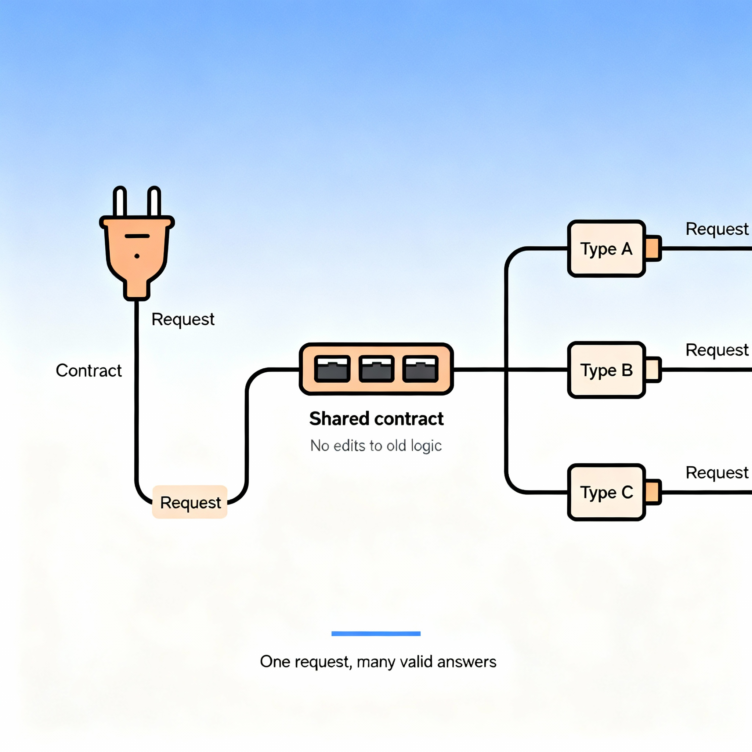
Polymorphism reduces branching
Many types respond to one request, cutting complex if‑else chains
Code targets shared contracts, not concrete case checks
New types slot in without editing old decision logic
Fewer branches mean clearer, safer, easier‑to‑test code

Slide 14

Working at Scale

Slide 15

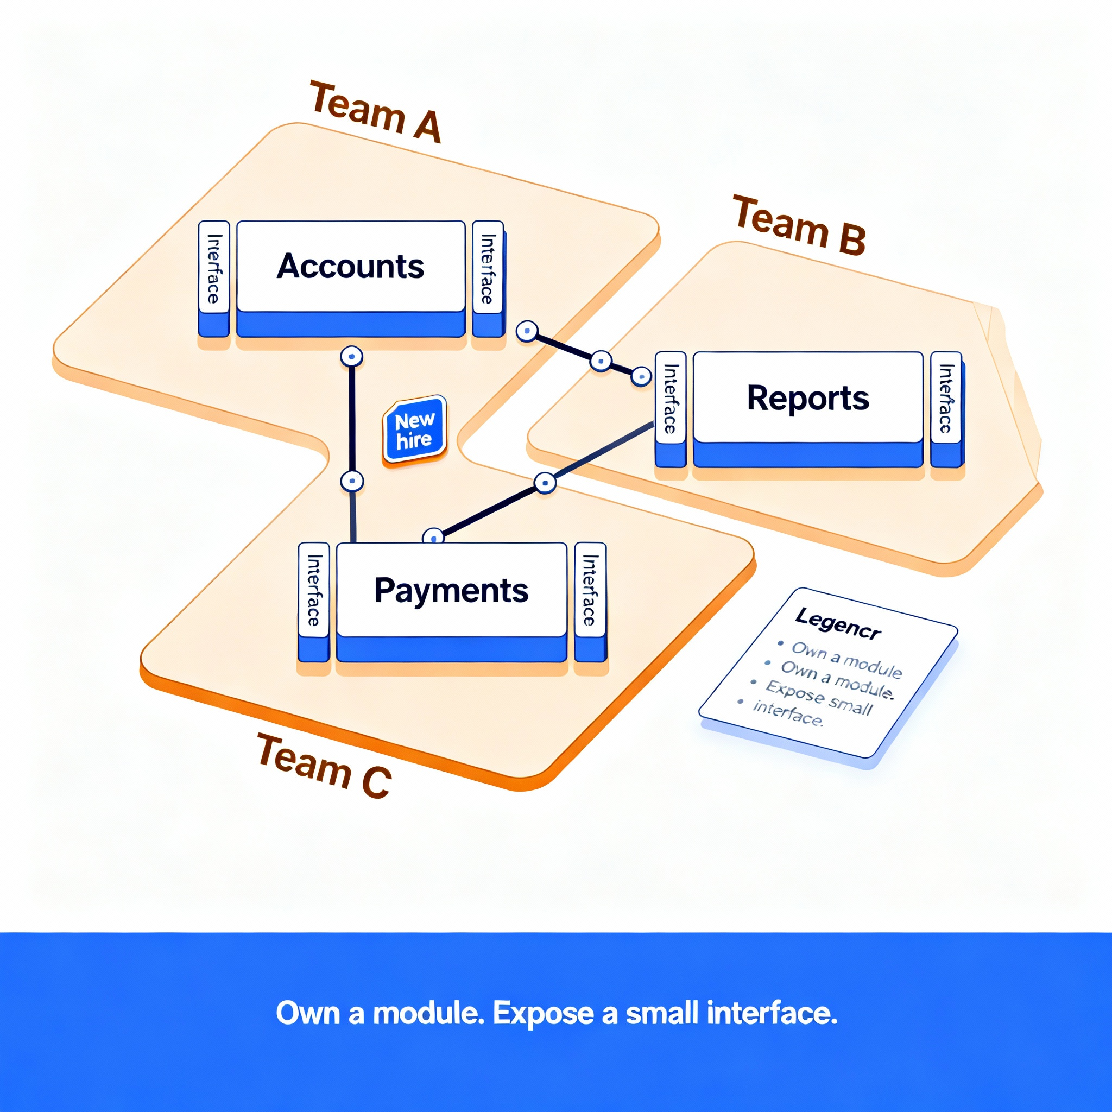
Team scalability and ownership
Clear module boundaries allow parallel work and safer integration
Teams own cohesive parts with stable interfaces between them
Small surfaces reduce coordination and merge conflicts
New members onboard faster with well‑named, self‑contained units

Slide 16

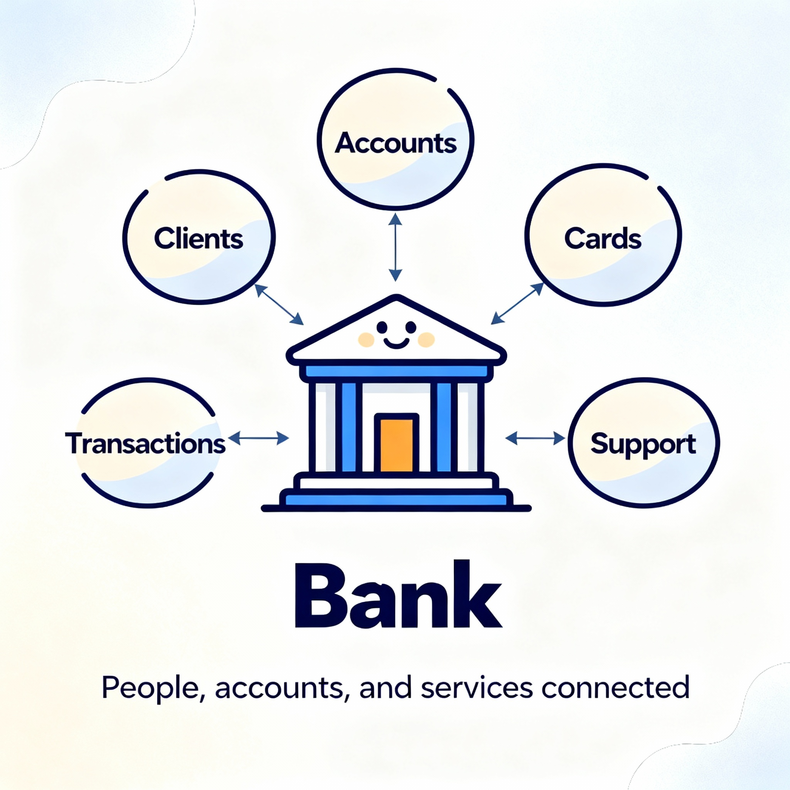
banking use case overview
A bank management domain to anchor ideas and connect weekly topics
We will model entities, rules, and actions
We will refine flows step by step as concepts deepen

Slide 17

Thinking in responsibilities
Give each part one clear job; avoid “does everything” modules
Cohesive responsibilities make code easier to read and test
Split formatting, storage, and business rules cleanly
Clear roles reduce hidden dependencies and surprises

Slide 18

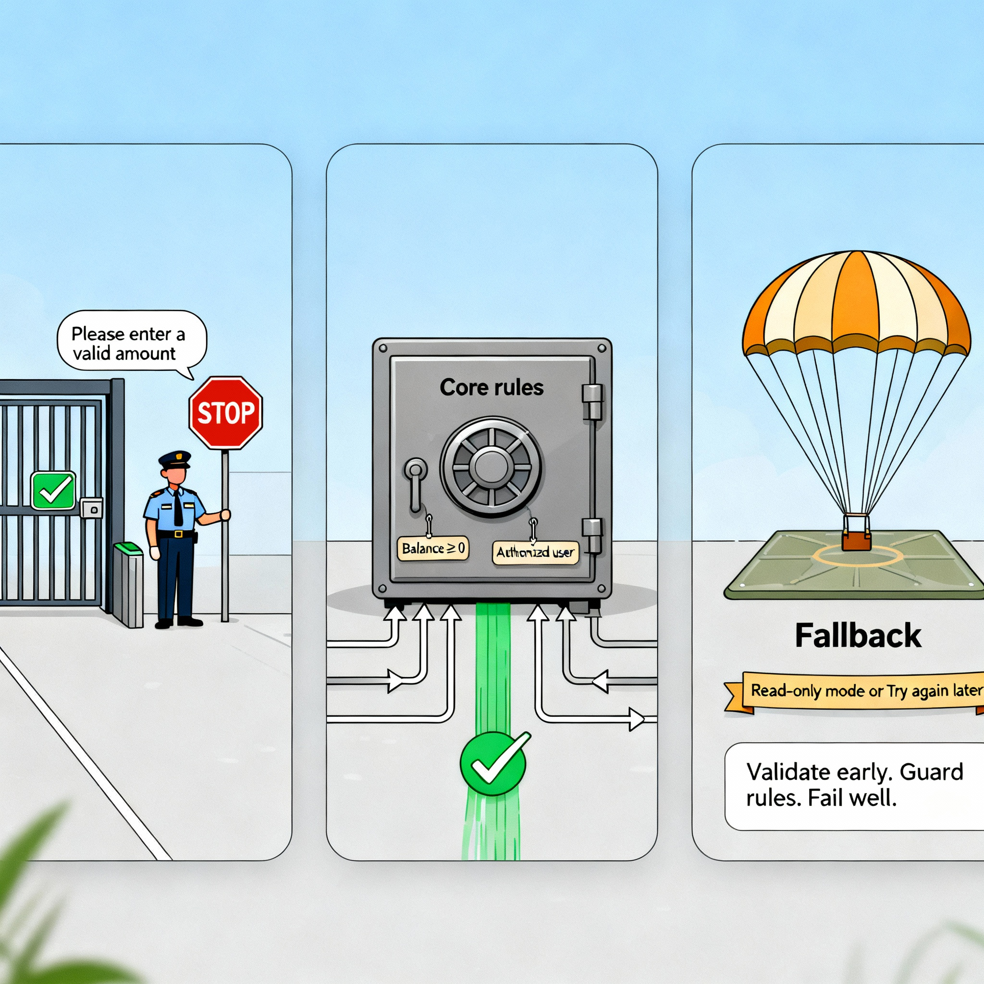
Robustness mindset (preview)
Plan for errors; keep rules true, even when things fail
Validate inputs early; fail fast with clear messages
Keep invariants central so they stay enforced everywhere
Handle failures gracefully; prefer recovery over silent corruption

Slide 19

Data and persistence (preview)
Separate core logic from storage to keep designs portable
Domain rules should not depend on storage details
Map objects to files or databases through adapters
This decoupling simplifies tests and future migrations

Slide 20

Modeling, Choosing, and Quality

Slide 21

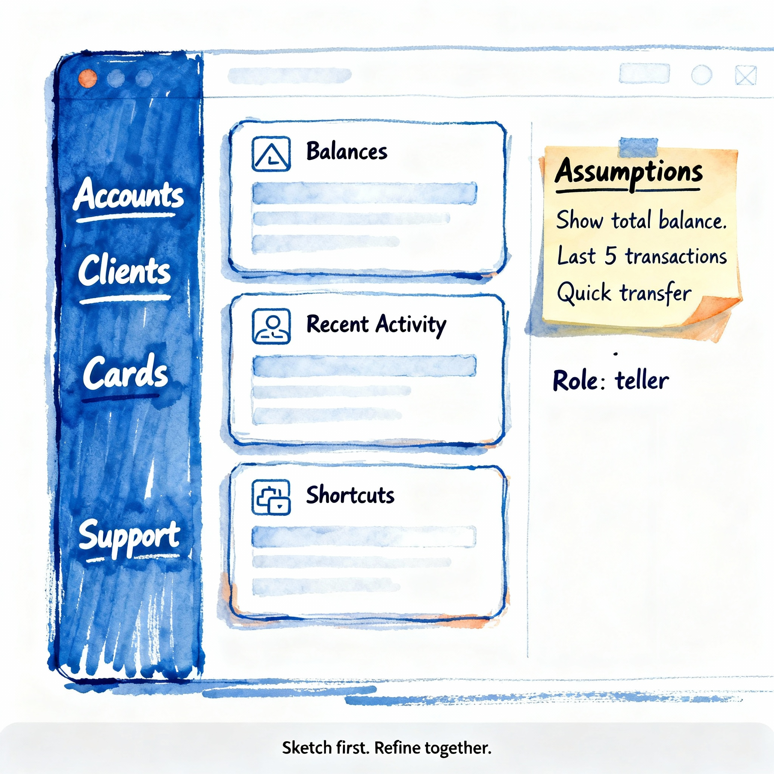
Visual modeling
Quick sketches align understanding before writing any code
Draw key parts, simple links, and rough responsibilities
Capture assumptions to revisit as details emerge
Keep diagrams minimal; update as ideas change

Slide 22

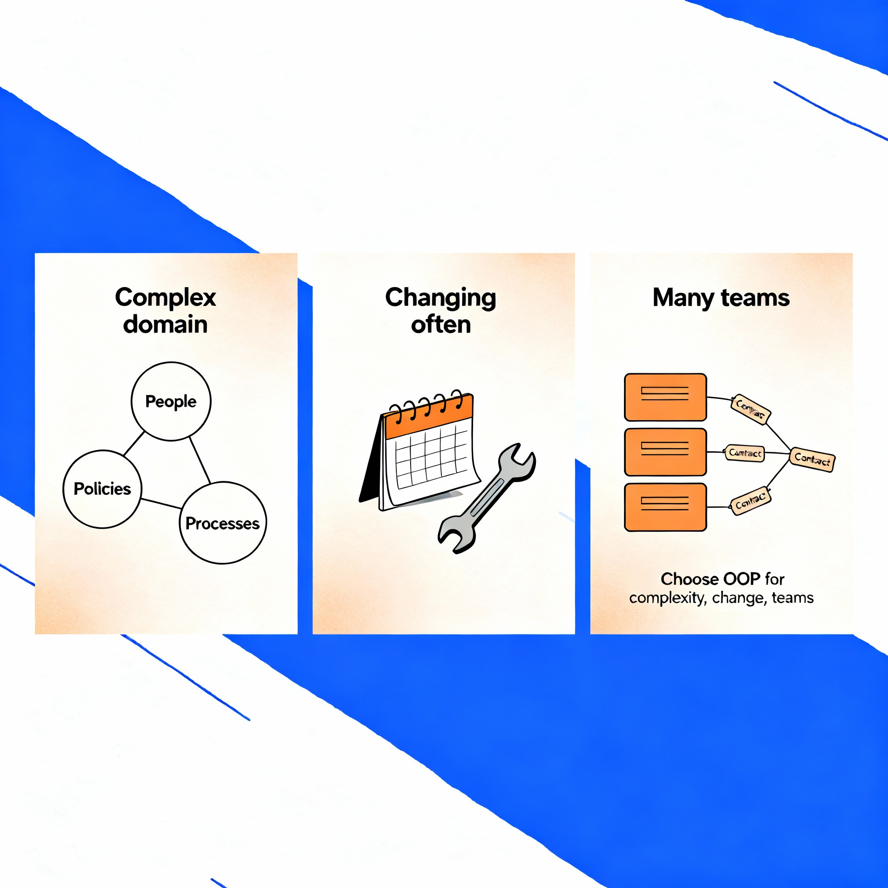
When oop is the right tool
Choose OOP for complex, evolving domains and long‑lived systems
Many interacting concepts benefit from clear models and boundaries
Frequent change and multiple teams favor modular, contract‑based designs

Slide 23

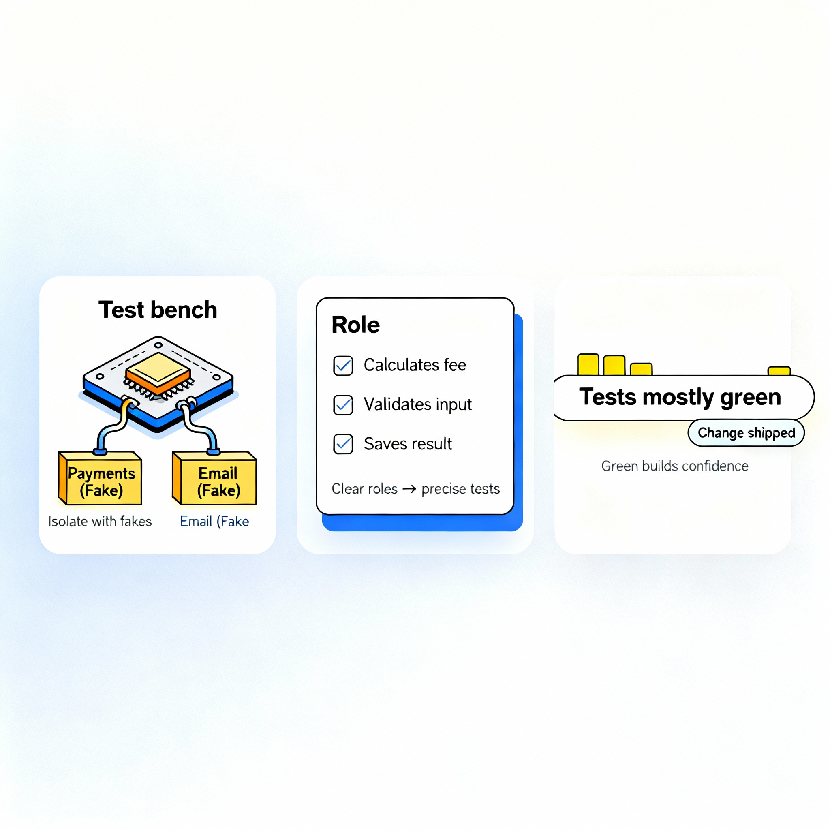
Value to testing and quality
Encapsulation and contracts make fast, focused tests possible
Test parts in isolation with fake collaborators behind contracts
Clear roles define precise, meaningful test cases
Confidence grows when changes keep tests green

Slide 24

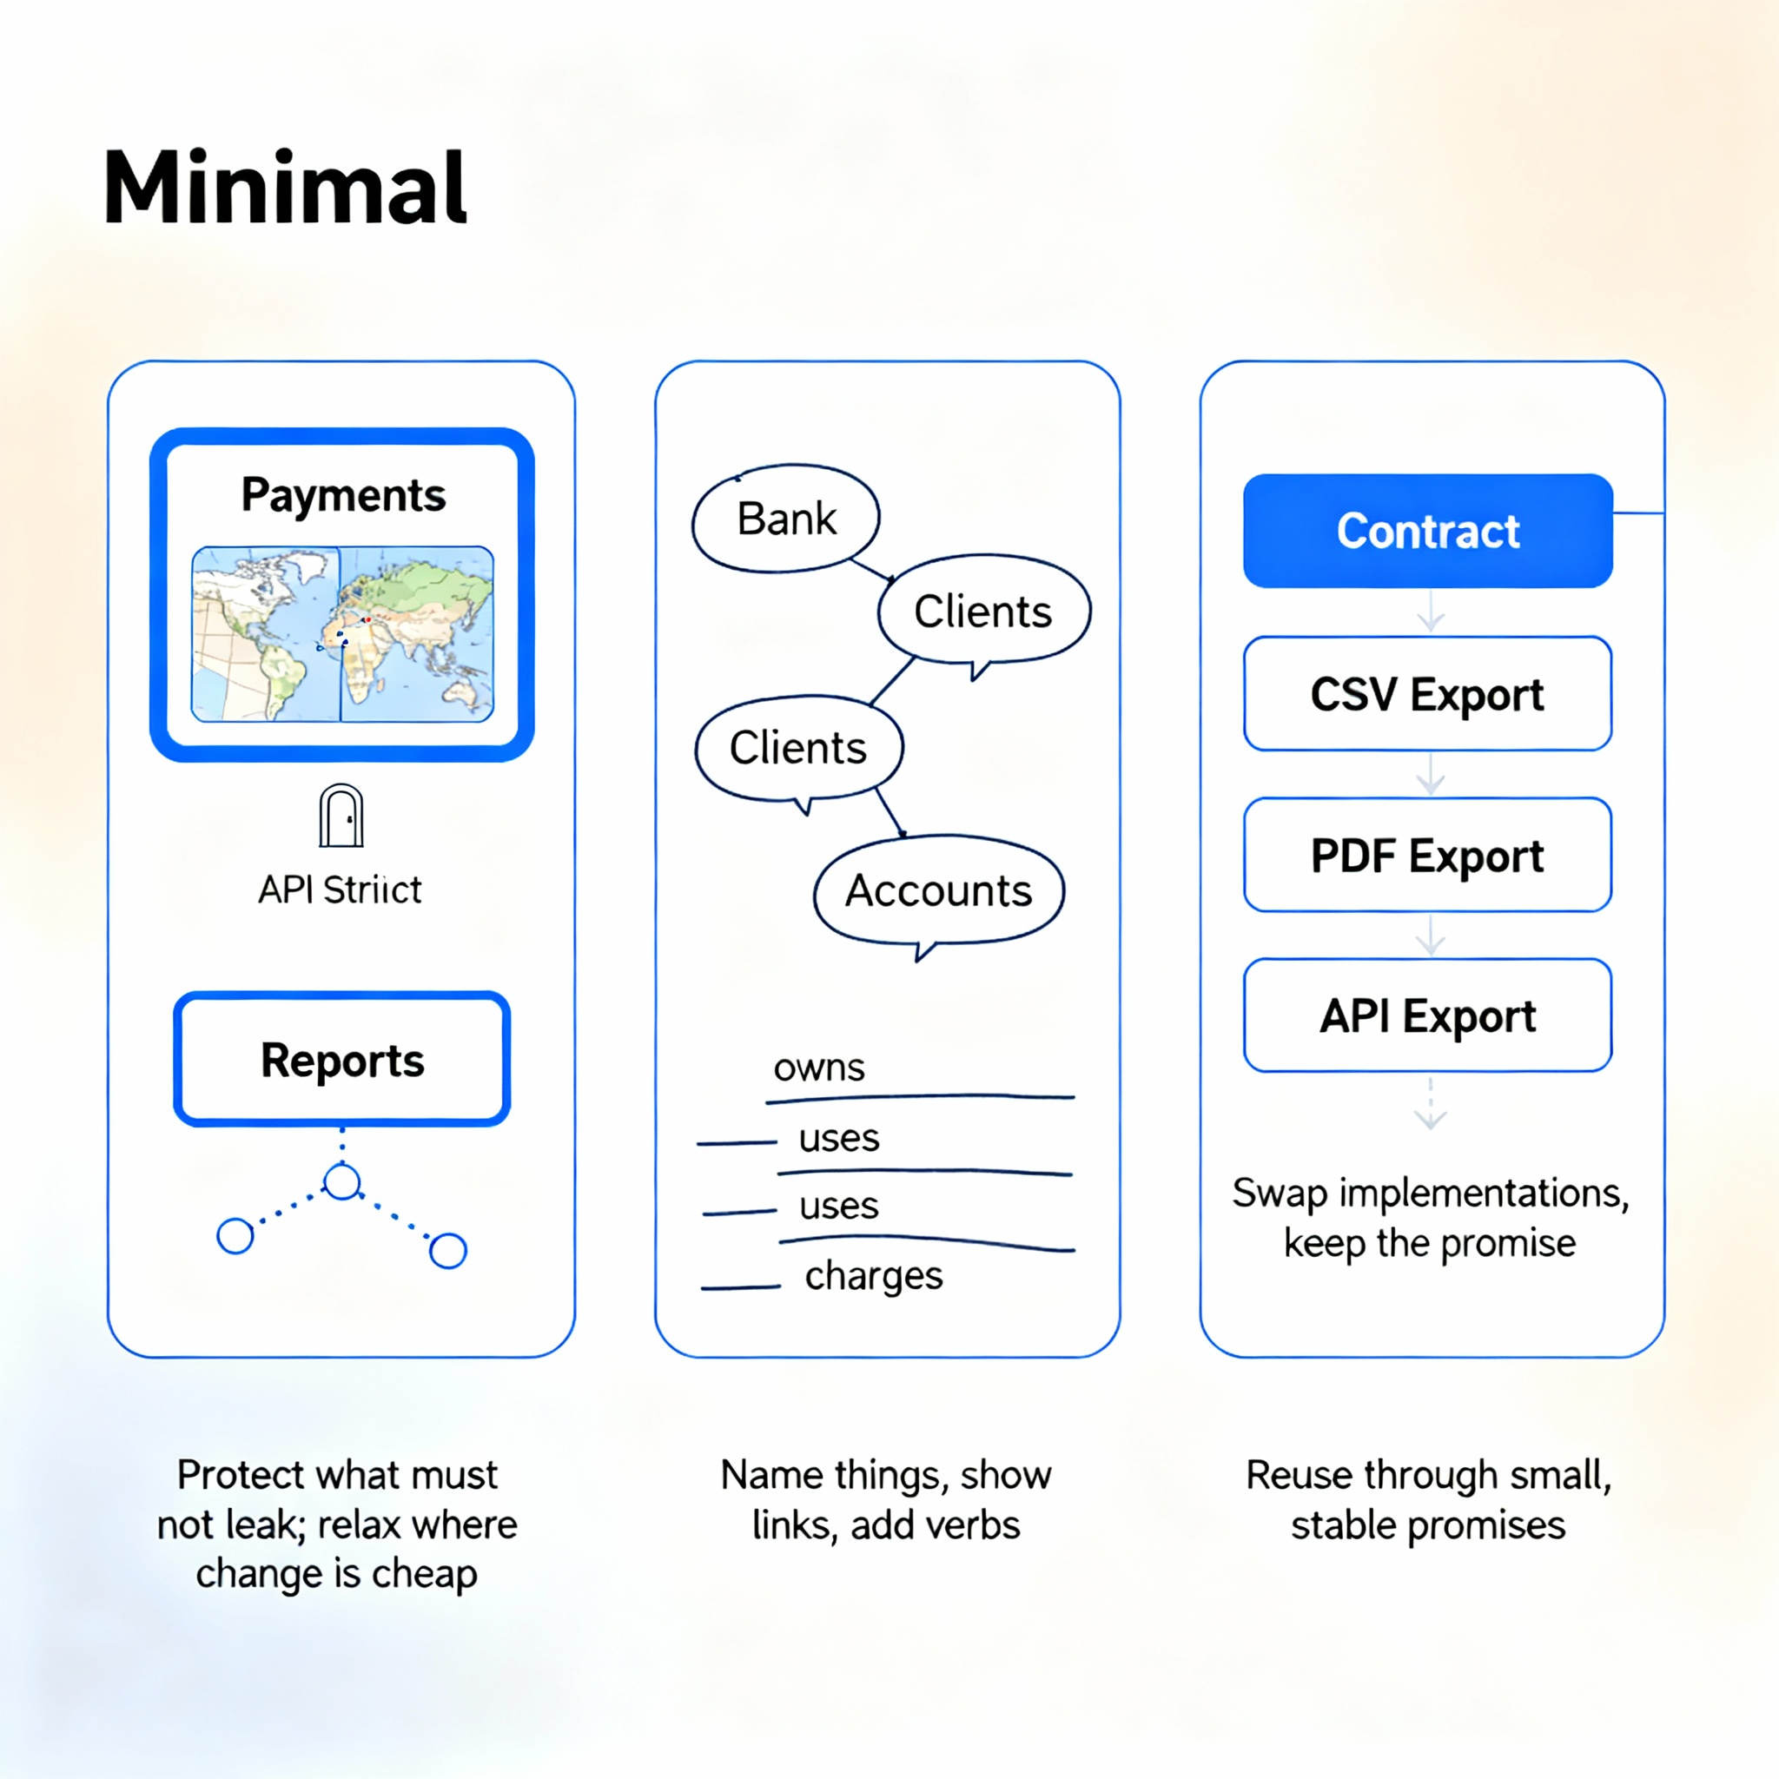
Quick thinking questions
Reflect together to connect ideas and surface trade‑offs early
Which parts deserve strict boundaries, and which can be flexible?
How to define entities and their relations and actions?
What contract would allow safe reuse across different features?

Slide 25

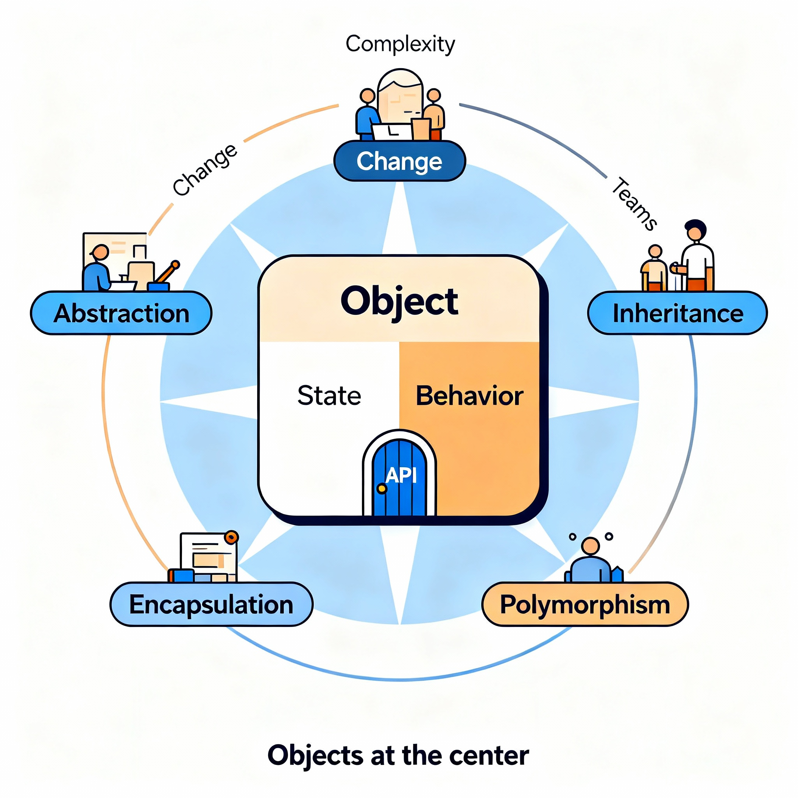
If you were to remember only one thing …
Objects help manage complexity, protect rules, and allow change
Model real things and actions with small parts that cooperate
Use the four pillars to keep designs clear, safe, and adaptable
Prefer clear contracts, and strong boundaries for growth

Slide 26


Quote of the week
Learn what to do; hide how to do it
That provides clarity in life and abstraction in OOP

